Slide 1


Equipment and Room Booking App
Naimuri
Wilson Ma
Junu Paneru
Yahya Muxumed
Wael Sherif
Daniel Macbooth
30 May 2024

Slide 2
Introduction
Developing a web application using a combination of front-end technologies like React.js and backend technologies like Express.js.
Key Activities:
Frontend Development with React.js:
Creating a React.js application to serve as the front end of our web application
Components were designed and implemented to create the user interface elements.
State management was handled using React's built-in state and hooks.

Slide 3
Introduction
Backend Development with Express.js:
Developed an Express.js server to handle backend operations.
Defined routes to handle HTTP requests from the front end.
Using MySQL as a Database

Slide 4
Introduction
User Authentication and Authorization:
Login and signup functionalities were implemented, allowing users to create accounts, log in with their credentials
User data was securely managed, with passwords hashed and stored in the database to protect against security vulnerabilities.
Create Authorisation by checking values in database.

Slide 5

Wilson Ma
Flinders University (Australia): Bachelor of Creative Arts (Digital Media), 2013
Digital Arts
History of Arts
3D Design
Web Development
Cinematography
Animation
Design experts, always focus on functionality and aesthetic. Have been creating content since 2010.
Team Leader of Team 1, Responsible for UI design, front-end development, and coordinating the entire project.

Slide 6

Junu Paneru
University of Greenwich (UK): Master of Art
Web Design and Content Planning
Saint Louis University (USA): BSIT
Data Structure, Web Technologies, Networking
Interest in front-end, Database design UI and UX design
Team Member of Team 1, responsible for Database Design in this project.

Slide 7
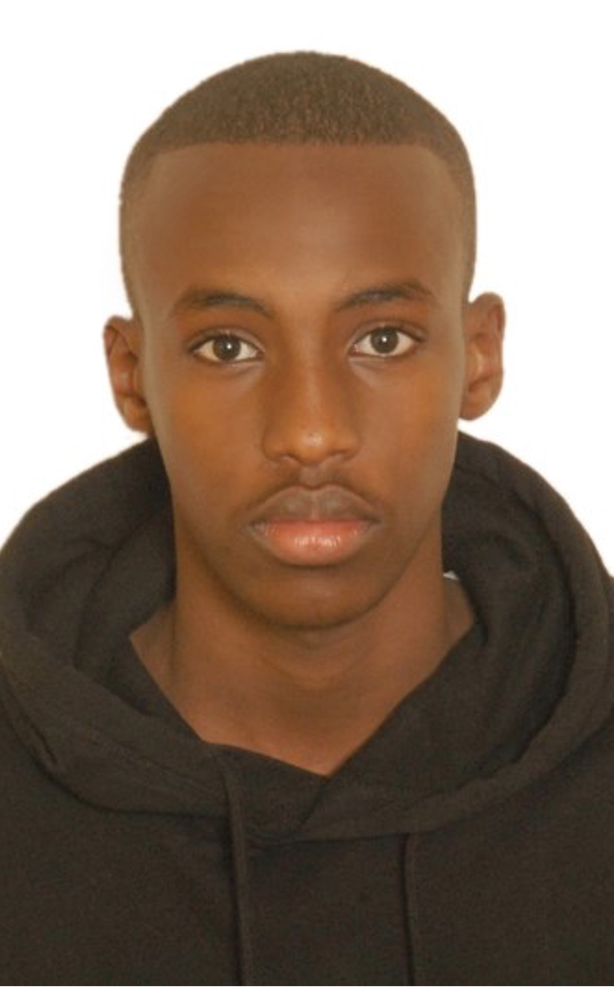
Yahya Muxumed
Middlesex University: BSc Information Technology
Computer Systems Architecture
Computing and Digital Technology
Research interests in Database Management Systems, Backend Development Frameworks and RESTful API Design and Development
Team Member of Team 1, responsible for backend development using Express.js, handling database interactions with MySQL and managing user authentication and authorisation.

Slide 8
Methodology

Slide 9
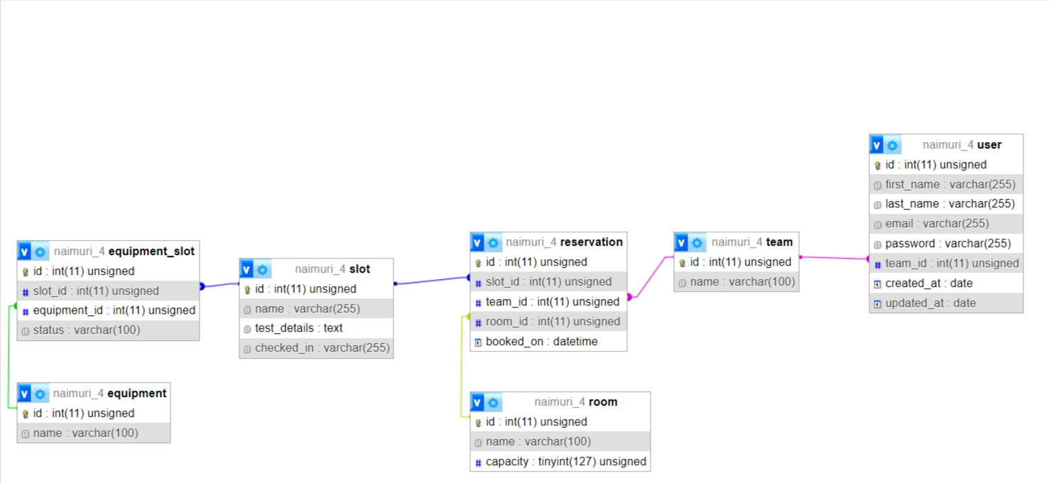
Initial Database Design
This was our initial Database Design which allows us to build Robust applications with flexibility.

Slide 10
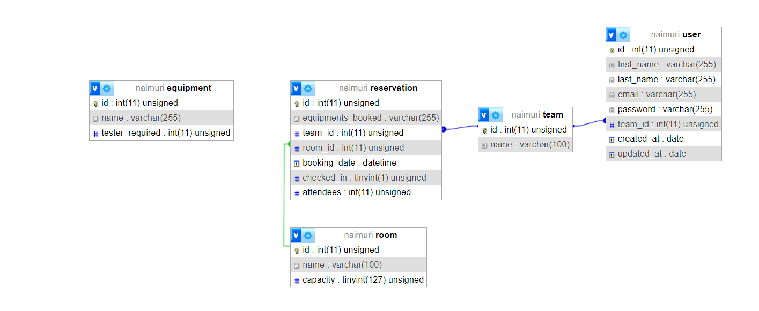
New Database Design

Slide 11
New Database Design
The ‘user, table stores user information.
The ‘team ‘table lists different teams by name.
The ‘reservation’ table contains records of reservations made by teams for specific equipment in particular rooms at certain times.
The ‘room’ table provides information about different rooms available for booking.
The ‘equipment’ table stores information about different pieces of equipment available for booking.
The relationship between the tables is shown in the diagram using foreign keys.

Slide 12
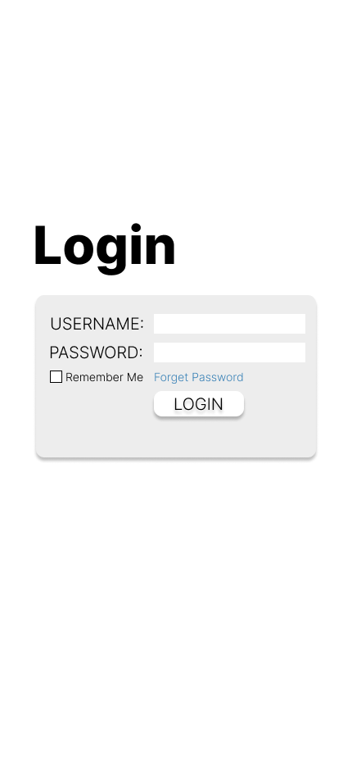
UI Design - Login
Login
Check Credentials
Check team_id
Route into User page if team_id not “1”
Route into Admin Page if team_id is ”1”

Slide 13
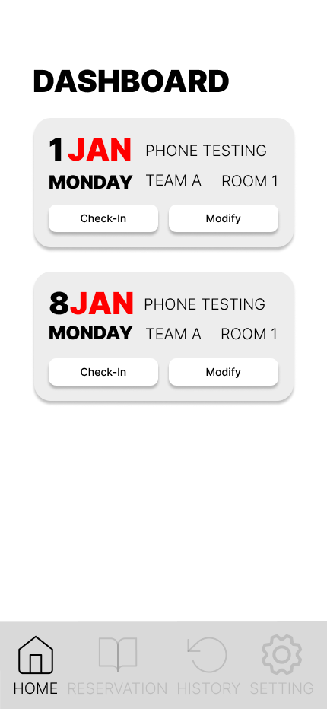
UI Design - Dashboard
Detail Displaying:
- Booking Date
- Testing Equipment
- Team’s Name
- Room Booked
Functionality:
1. **Check-in**: Mark their bookings as checked-in
2. **Modify Booking**: Change the booking date and room

Slide 14
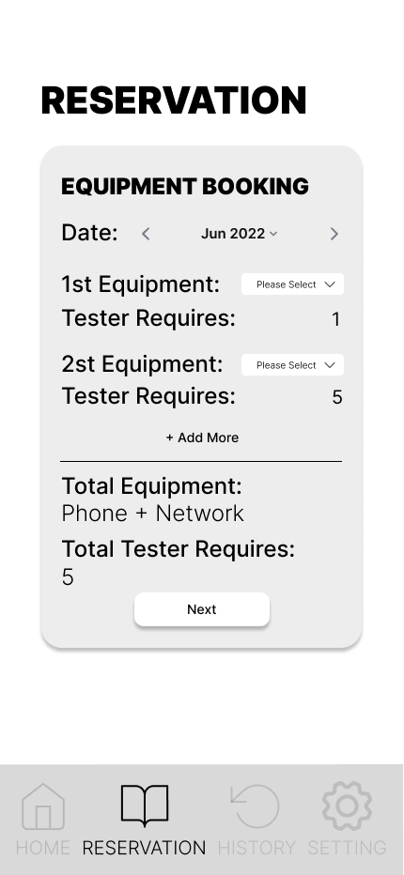
UI Design - Reservation
1. Equipment Booking:
- Select the booking date.
- Choose one or multiple pieces of equipment - The table will display equipment along with the number of testers required.
2. Room Booking:
- Select a room with a capacity that is larger than the number of testers required.
- The system will update the room's available capacity based on the selection.

Slide 15
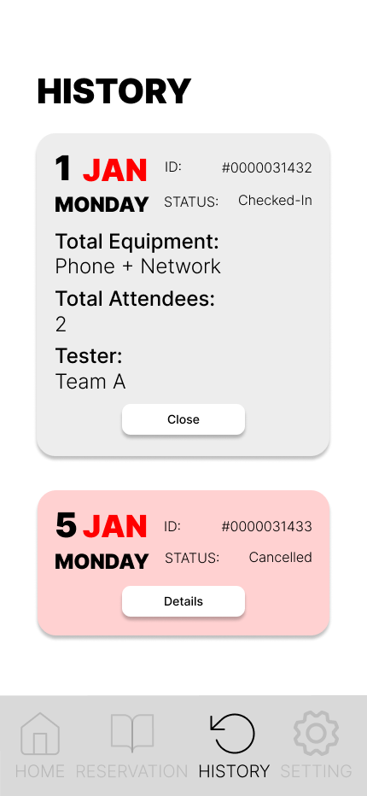
UI Design - History
History Tab Display:
- Dates: The date(s) of the reservation.
- Booking ID: Unique Identifier
- Status: Checked In, Cancelled
- Booked Equipment: Equipment booked- Attendees: The number of testers or participants for the reservation.
- Team ID: The team associated with the reservation.

Slide 16
UI Design - Prototype
https://www.figma.com/proto/y7cAPTnPvGcVEqS26dxSLU/booking-apps?page-id=0%3A1&node-id=14-3&viewport=-1052%2C511%2C1&t=sweoNI9XUMswMJv0-1&scaling=scale-down&starting-point-node-id=1%3A2

Slide 17
Technology Behind

Slide 18
Conclusions

Slide 19
Evaluation
What went well?
What would you do differently next time?
What would you change?
What did you enjoy the most?
**You can be honest here, but keep it on a professional level**

Slide 20
Thank you for listening! Any questions?
0161 686 5770
info@in4group.co.uk
Twitter @IN4Group
www.in4group.co.uk

